Slide 1

Micro Credit Defaulter Project
BY KUNIGIRI NAGARAJU

Slide 2
Overview
A Microfinance Institution (MFI) is an organization that offers financial services to low income populations
Microfinance is widely accepted as a poverty-reduction tool, representing $70 billion in outstanding loans and a global outreach of 200 million clients.
They are working with one such client that is in Telecom Industry. They are a fixed wireless telecommunications network provider.
They are collaborating with an MFI to provide micro-credit on mobile balances to be paid back in 5 days
The loan amount of 5 and 10 (in Indonesian Rupiah), payback amount should be 6 and 12 (in Indonesian Rupiah) respectively.
In order to improve the selection of customers for the credit, the client wants some predictions that could help them in further investment and improvement in selection of customers.

Slide 3
Problem statement
The idea of this project is to build a model which can be used to predict in terms of a probability for each loan transaction, whether the customer will be paying back the loaned amount within 5 days of insurance of loan or not.

Slide 4
Project Objective
Build a model which can be used to predict in terms of a probability for each loan transaction, whether the customer will be paying back the loaned amount within 5 days of insurance of loan.

Slide 5
Approach
Study the data set provided by the client
Understand the key feature and learn customer behaviour
Visualize pattern
Abstract best feature to fit the model
Create multiple model and do proper Hyperparameter tuning and choose the right evaluation metrics to finalize the model.

Slide 6
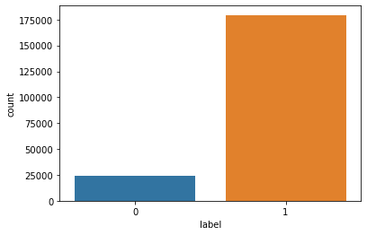
EDA AND VISUALISATIONS
Label is our target variable and it is clearly imbalance.

Slide 7
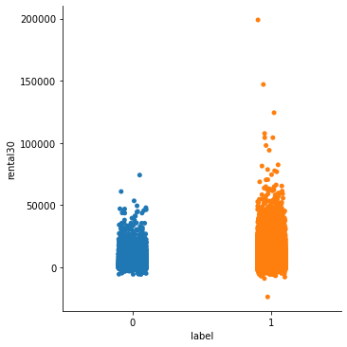
EDA AND VISUALISATIONS
The above data shows that customer who maitains balance of over 50000 in last 30 days is less likely to default the loan

Slide 8
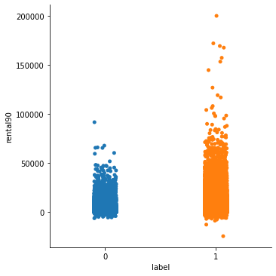
EDA AND VISUALISATIONS
The above data shows that customer who maitains balance of over 50000 in last 90 days is less likely to default the loan

Slide 9
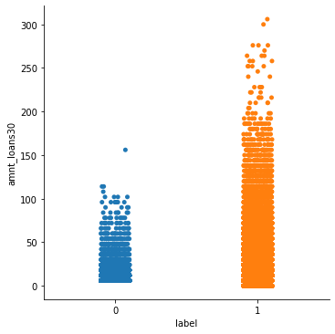
EDA AND VISUALISATIONS
Customer who take more than 50 loans in last 30 days are less likely to default the loan.

Slide 10
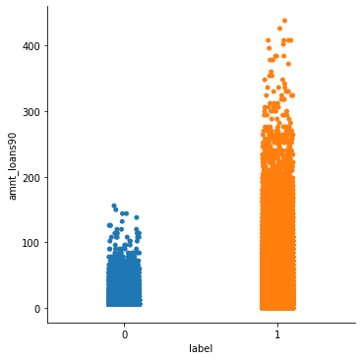
EDA AND VISUALISATIONS
Customer who take more than 90 loans in last 90 days do not default their payment.

Slide 11
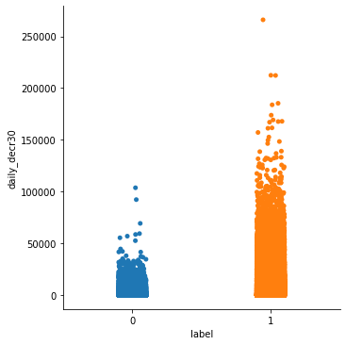
EDA AND VISUALISATIONS
The above data clearly shows that if customer is spending daily average of over 40000 in last 30 then they are more likely to pay the loan.

Slide 12
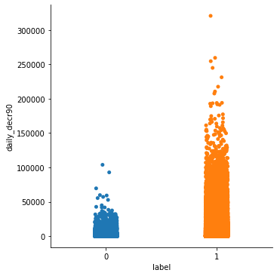
EDA AND VISUALISATIONS
The above data clearly shows that if customer is spending daily average of over 40000 in last 90 then they are more likely to pay the loan.

Slide 13
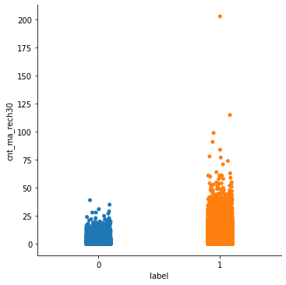
EDA AND VISUALISATIONS
If the customer is recharging the main account more than 20 times in last 30 days then they are more like to pay the loan amount.

Slide 14

EDA AND VISUALISATIONS
If the customer is recharging the main account more than 20 times in last 90 days then they are more like to pay the loan amount.

Slide 15
Method
Used Python for coding.
Various libraries were used.
Algorithm used for model fitting.
ROC_AUC Curve was used to determine the performance of he model
GridSearchCV was used to Hypertune the model.

Slide 16
Findings
Customer who maintains average balance of over 50000 in last 90 days is less likely to default the loan.
Customer who takes average of 90 loans in last 90 days are less likely to default the loan.
Customer spending daily average of over 40000 in last 90 then they are more likely to pay the loan.
Customer who are recharging its main account 20 times in the last 90 days is less likely to default the loan.
If company is issuing loan 1st time to the customer they should look at their average balance, average daily spending and recharge ability over last 90 days. If all this parameters are low then they are chances customer mite default the loan.
Customers who are using the telecom services for a long time are mostly non- defaulters and company should try and retain those customer by introducing value added services.
Company do not have high number of defaulters. A reminder service should be introduce to remind customer about the timely repayment of their loan.

Slide 17
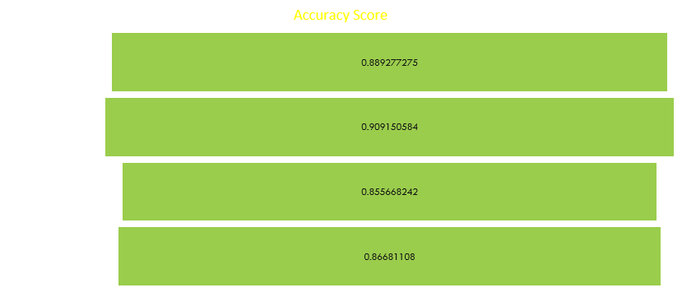
Models used and outcome

Slide 18
MEAN ACCURACY

Slide 19
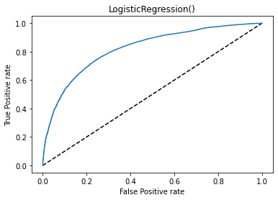
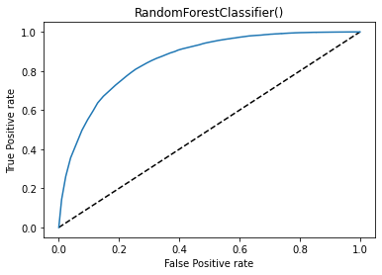
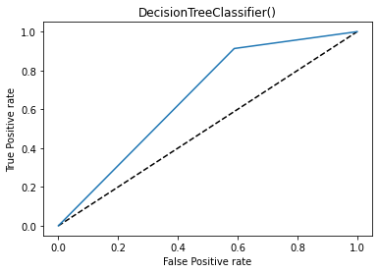
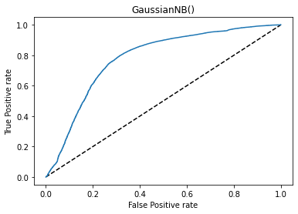
ROC_AUC

Slide 20
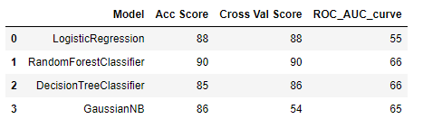
STUDY COMPARISON SCORE

Slide 21
FINAL Model Selection
From all the model Random Forest has given us the best output of accuracy of 90.50% with ROC_AUC score of 61.30%.
The lower ROC_AUC score is because our data is highly imbalanced.

Slide 22
CONCLUSION Scope For Improvement
Since its class imbalance we can use oversampling and under sampling using SMOTE and NearMiss respectively to check if that can offer me a better result.
Feature extraction if possible to give us the best results.

Slide 23
Thank You

